Slide 1
AICTE DATA ANALYTICS INTERNSHIP
Customer Churn Prediction & RFM Analytics
Predictive Machine Learning Pipeline for Proactive Revenue Retention & Customer Risk Scoring
Author: Pranay
Focus: Predictive Modeling
Stack: Python, Pandas, Scikit-learn

Slide 2
PROJECT OVERVIEW
Executive Summary
5x
Core Objective
Transform raw transaction logs into customer-level RFM metrics to build an automated churn prediction model.
Higher cost to acquire new customers than retaining existing ones
Proactive Retention vs Reactive Customer Recovery
Machine Learning Focus
Supervised classification via Random Forest model

Slide 3



BUSINESS CHALLENGE
The Cost of Unidentified Churn
Revenue Decay
High CAC Pressure
Delayed Action
Unmonitored churn leads to direct erosion of recurring revenue and lifetime customer value.
Replacing lost accounts requires intensive ad spend and high acquisition budgets.
Re-engaging clients after total disengagement yields low response rates.

Slide 4
TECHNICAL PIPELINE
End-to-End Analytics Workflow
STEP 01
STEP 02
STEP 03
STEP 04
Data Cleaning
RFM Extraction
Model Training
Risk Scoring
Standardizing string formats and handling missing order values.
Aggregating transactions to Recency, Frequency & Monetary metrics.
Random Forest Classification on 80/20 train-test split.
Exporting High/Low risk classifications for automated campaigns.

Slide 5
FEATURE ENGINEERING
RFM Behavioral Metrics Framework
Metric | Definition | Data Type | Churn Signal Threshold
Recency | Days elapsed since last customer transaction | Integer (Days) | > 180 Days Inactive
Frequency | Total completed transaction count | Integer (Count) | < 10 Total Orders
Monetary | Cumulative lifetime revenue generated | Float ($ USD) | LTV Segmentation Cushion

Slide 6
MODEL RESULTS & EVALUATION
Performance Metrics & Confusion Matrix
94%
Confusion Matrix Visualization
Model Precision
Minimizes false positive alerts for marketing teams
1,820
116
True Churn
False Alarm
(Correct Risk)
(Low Impact)
Model Recall
91%
Captures true at-risk accounts prior to disengagement
180
3,884
Missed Churn
ROC-AUC Score
0.96
(Action Needed)
True Loyal
(Retained)
High classification separation ability across threshold range
Random Forest Model trained on 100 Decision Trees with 80/20 train-test split.

Slide 7

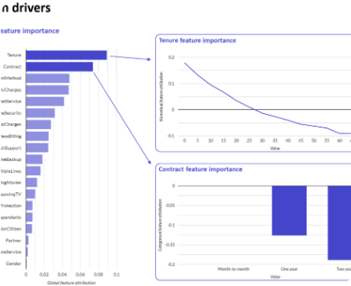
FEATURE IMPORTANCE ANALYSIS
Key Behavioral Predictors of Churn
Random Forest Gini Feature Importance
1. Recency (Days Inactive)
48.2%
2. Frequency (Order Count)
27.5%
3. Monetary (Lifetime Spend)
14.8%
4. Avg Order Value (AOV)
9.5%

Slide 8
BEHAVIORAL INSIGHTS
Key Drivers of Churn Behavior
> 180 Days
< 10 Orders
High LTV
Recency Spike
Low Order Frequency
Monetary Cushion
Inactivity over 180 days represents the highest single predictor of permanent account loss.
Accounts with under 10 historical orders lack habitual brand loyalty and show high vulnerability.
High cumulative historical spend acts as a buffer against short-term inactivity intervals.

Slide 9
STRATEGY
Actionable Retention Recommendations
High-Risk Re-Engagement
VIP Loyalty Rewards
Trigger automated email discounts and personalized win-back offers for accounts entering the 180+ day recency threshold.
Establish exclusive perks and priority customer support for high-frequency, high-monetary accounts to maintain long-term retention.

Slide 10
PROJECT DELIVERABLES
Internship Package Deliverables
Jupyter Code
Dependencies
Project Report
Documentation
Pranay_CustomerChurnPrediction.ipynb
requirements.txt
Pranay_ProjectReport.docx
README.md

Slide 11
AICTE INTERNSHIP PROJECT
Thank You!
Customer Churn Prediction & Predictive Analytics Presentation
Presented by Pranay

Slide 12

Image Sources
https://spyro-soft.com/wp-content/uploads/2023/07/churn-drivers-1024x715.png
Source: spyro-soft.com

